Slide 1

Survey Dates:
June 2nd – June 30th
Notes:
Intro to Speakers

Slide 2

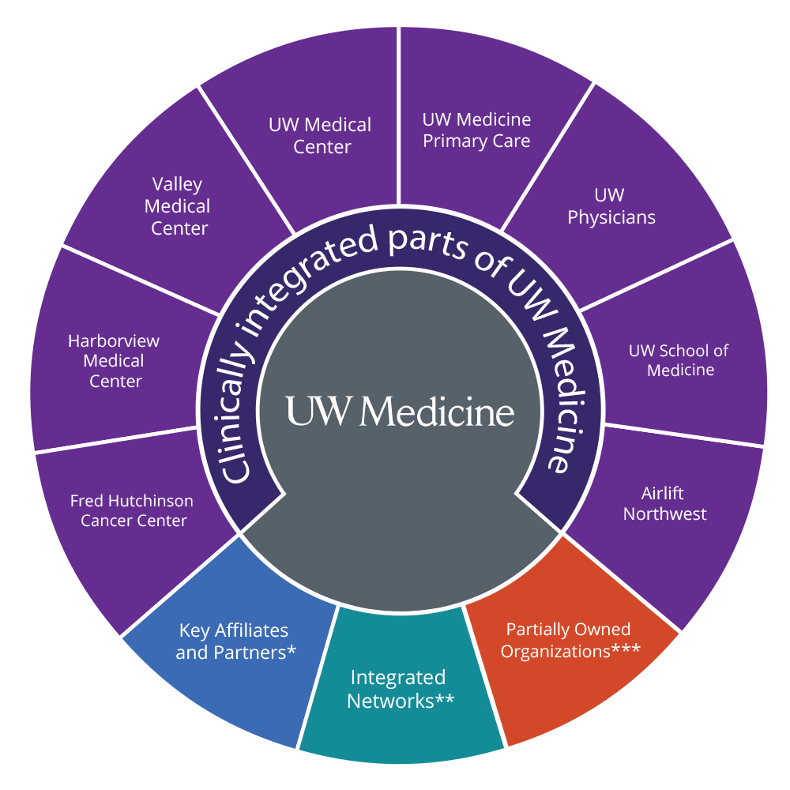
UW Medicine Inclusive Climate Survey
Key Purpose: In January 2023, the Office of Healthcare Equity launched the UW Medicine Equity, Diversity, and Inclusion (EDI) Survey to establish baseline measures of EDI across UW Medicine and generate actionable insights to drive meaningful improvements.
We are now preparing to relaunch the survey this June. It will be the same as before—available to all paid UW Medicine employees, translated into six languages, and taking approximately 12 minutes to complete. A post-survey dashboard will also be available for all employees to view results. The only update is the survey’s name: it is now called the UW Medicine Inclusive Climate Survey.
Participants
Survey Launch Date
Includes all staff.
All regular & research Faculty.
Includes other faculty tracks across entities paid by UW.
Residents
Post - docs / Fellows
June 2 -30th, 2025
Survey Length
Approx. 12 to 15 min
69 Questions
Notes:
Read through Key Purpose
"2025 UW Medicine Equity, Diversity, and Inclusion Survey" to the "2025 UW Medicine Inclusive Climate Survey." We wanted a title that more directly reflects our goal of fostering an inclusive environment and encourages broad participation. “
When Survey launched in 2023, it was the most inclusive survey ever conducted across UW Medicine.
"Inclusive Climate" combines the overall workplace atmosphere ("climate") with the core goal of fostering a sense of belonging, where every individual feels welcomed and valued.
Additional rationales if more questions:
“Inclusive” as being less divisive or attention attracting compared to “DEI” or “EDI”.
“Inclusive Climate” further differentiates from the main campus “UW Climate Survey”, “Well-Being” and “Workforce Engagement/Annual Workforce” Because they’re so close in timing, need something more specific to distinguish.
All UW Medicine Employees receive email invite on June 2nd but the QR code will also be another route to get to the survey.

Slide 3
GOALS for 2025 Inclusive Climate Survey
Improve response rate from 39% to 60%
Share results with respect to 2023 responses and associated Action Plans
Promote systemwide interventions based on results
Notes:
Read through Goals.
60%
Follow up with those that completed action plans, to ensure accountability and support!
Based on feedback, respecting local environments and efforts wholeheartedly, AND, dedicating more energy to systemwide interventions to benefit all

Slide 4
UW Medicine Inclusive Climate Survey
Feature Area | 2023 Foundation | 2025 Enhancements
Dashboard | Public & Private Views | + New Views (Feedback-Driven + Trending data), Deeper Drill-Down (Staff Roles & Professorial Tracks)
Reporting | One Report (~5 mo) | 🚀 Faster (~2 mo), Individual Leader Reports, Presentation Kits Provided
Action Planning | 33 Action Plans Completed 48 Leadership teams engaged 2024 Workforce Experience Event | 🎯 Direct Leadership Follow-Up (Accountability), Alignment w/ Blueprint 3.0 Systemwide interventions
Skill Building | (Initial resources established) | 💡 Focused Trainings: Psych Safety, Restorative Practices, Bystander Intervention, etc.
Participation | 39% Response Rate (~10k voices) | 📈 Goal: 60% Response Rate (~15k voices) Response Rate Dashboard during open period

Slide 5
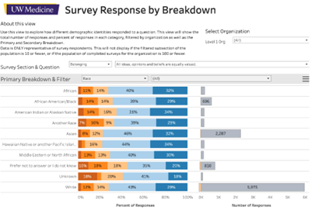

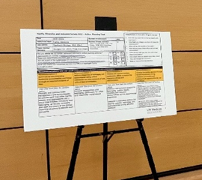
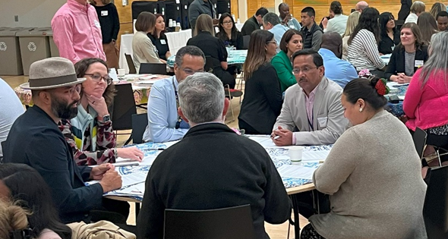
Your Voice, Our Action: Transforming UW Medicine Together
Seeing the Full Picture, Thanks to You
Your feedback helped us build a Transparent Dashboard that provides a comprehensive view of our organization across four levels (Entity, Department, Division, Team).
Open Insights for All
Our Simplified Public Report makes key findings accessible to everyone, fostering transparency and shared accountability in our EDI journey.
Turning Feedback into Local Impact
Our Action Planning Tools are directly informed by the themes you raised in the survey.
Leadership Committed to Change
Your feedback has strengthened the commitment of 48 leadership groups across UW Medicine.
39% response rate
Notes:
You shared your valuable insights through the 2023 EDI Survey, and we heard you. At UW Medicine, we’re committed to translating your feedback into meaningful action, fostering a more equitable, diverse, and inclusive environment for everyone. Here’s how your input is shaping our progress:
Seeing the Full Picture, Thanks to You
Your feedback helped us build a Transparent Dashboard that provides a comprehensive view of our organization across four levels (Entity, Department, Division, Team).
Open Insights for All
Our Simplified Public Report makes key findings accessible to everyone, fostering transparency and shared accountability in our EDI journey.
Turning Feedback into Local Impact
Our Action Planning Tools are directly informed by the themes you raised in the survey. While centered around four system-wide recommendations designed to address key EDI challenges, these tools empower local teams to develop and implement solutions that are relevant and impactful within their specific contexts.
Leadership Committed to Change
Your feedback has strengthened the commitment of 48 leadership groups across UW Medicine, including Clinical Leadership Teams, SOM Department Leaders, and System Leaders. This interconnected network ensures that EDI is a priority at every level of our organization.

Slide 6
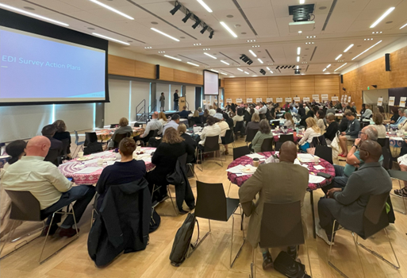
Your Voice, Our Action: Transforming UW Medicine Together ​
Working Together for a Better Experience
The Workforce Experience Event was held in direct response to the themes highlighted in the survey. Leaders gathered to review shared priorities from your feedback and related Action Plans, and to discuss system-wide strategies addressing key areas. These included improving transparency in bias reporting, fostering psychological safety, empowering bystander intervention, and investing in restorative practices aimed at healing, repair, and building inclusive communities.
Review common priorities identified in your feedback and subsequent Action Plans.
Share system-wide strategies to address key areas you raised.
Investing in Restorative Practices
Notes:
Review common priorities identified in your feedback and subsequent Action Plans.
Share system-wide strategies to address key areas you raised, including:
Improving Transparency in Bias Reporting: We are actively working to enhance the Bias Reporting Tool and associated processes based on your feedback.
Fostering Psychological Safety: Creating a workplace where everyone feels safe, respected, and valued.
Empowering Bystander Intervention: Equipping our community to actively support and advocate for one another.
Investing in Restorative Practices:
Healing and Repair: Developing approaches to address harm in a way that promotes understanding and reconciliation.
Building Inclusive Communities: Proactively fostering connections and preventing harm through community building.

Slide 7
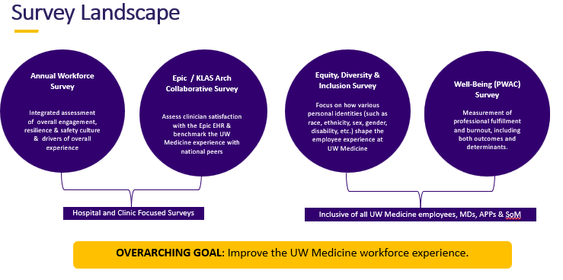
Your Voice, Our Action: Transforming UW Medicine Together ​
Data-Driven Progress, Guided by You
The launch of our Survey Integration Team underscores our commitment to continuously listening and learning from your experiences.
Wait, what about the Campus Climate survey?
Notes:
One other outcome of the survey, was launch of Survey Integration team, bringing together Well Being, Workforce Engagement, Healthcare Equity and IT.
Including a single website to host information related to Workforce Surveys.
We’ve worked together to consider timing of surveys, as well as reduced duplication questions. We’re also working together to help really create an overarching picture of the employee experience. These concepts are related!
Campus Climate survey- IT IS DIFFERENT
Upper campus survey
30 minutes
Offered by office of minority affairs
Every 5 years
Broad survey
Results coming out winter 2026
Inclusive Climate Survey
Specific to UW Medicine climate
our data will be way more specific to your individual teams because of the way we use workday data
Average time to take the survey is 12.5 minutes
Every other year
More results = more data to make accurate action plans and create change.

Slide 8
Communication Plan
Pre-Survey
Survey Promotion Meetings
Manager, dept, team, unit meetings
Messages
Tim Dellit and Paula Houston message
CEO Messages
Manager Listserv
EDI Champions listserv
Vitals Stories
2023 Outcomes and Impacts
Digital assets
Printed materials
Video
Survey Launch
All UW Medicine Employees receive email invite
Survey Promotional Meetings
Emails to Managers
Response rate updates
Reminder emails for incomplete surveys
Post Survey
Share out meetings
Manager, dept, team, unit meetings
Dashboard Trainings
Report and Dashboard
Vitals Story
Response rate and next steps
Action Planning Workshops

Slide 9





We need your help!
Communicate the "Why":
Explain how feedback improves your team & UW Medicine's inclusivity goals.
Share your personal support & why you believe it's important.
Authorize Work Time:
Clearly permit & encourage using ~15 minutes of work time.
Suggest blocking calendar time
Reinforce Trust & Confidentiality:
3rd-party admin, responses aggregated (groups 5+), strictly confidential & voluntary.
Direct questions to FAQ or Callie Hunter (callieh@uw.edu)
Lead by Example:
Share that you are participating and value the process.
Commit to Follow-Up:
Pledge to discuss your team's aggregate results (when available) & develop action steps together.
Notes:
How can you drive participation and ensure we get robust actionable feedback?

Slide 10
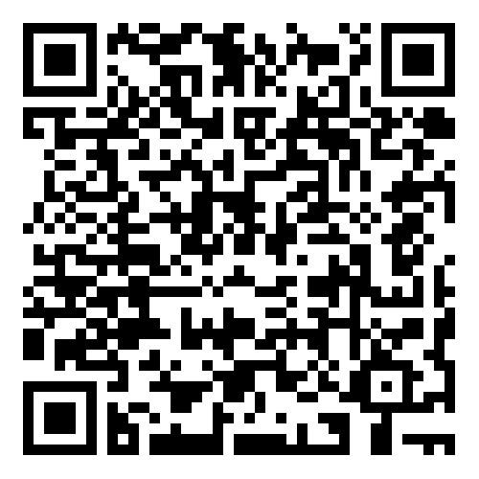
Stay updated on our survey webpage equity.uwmedicine.org/inclusive-climate-survey/
Notes:
Campus Climate Survey –
“Additionally, the passage of Senate Bill 5227 (SB 5227) in June 2021 by the Washington State Legislature also requires that our state’s public higher education institutions conduct campus climate assessments at least once every five years. ” (2025, 2030, etc)
UW Medicine included more explicitly because of recent Office of Civil Rights Findings
UW main campus driving and running this effort
Campus wide reports expected in late Fall/Winter
Open April 22 – May 22

Slide 11
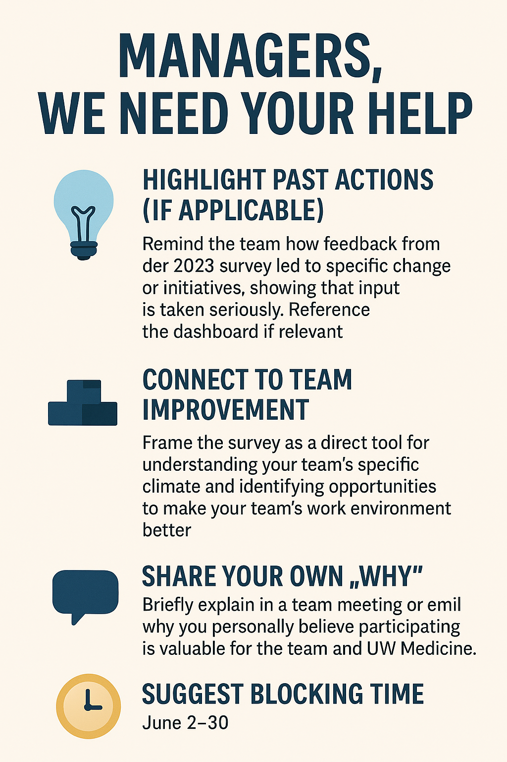
Your Voice, Real Impact.
Own the outcome! How will you personally drive participation to ensure we get robust, actionable feedback?"
Notes:
How can you drive participation and ensure we get robust actionable feedback?

